Slide 1




C l u s t e r i n g
A n a l y z e t h e c l u s t e r i n g p e r f o r m a n c e o f k - M e a n s
To m a s z J a n e c z k o , L u k á š H of m a n
1

Slide 2




Problem
Yeast cells can change into a special kind of cell called a spore. This change is called sporulation. By examining how the genes in these yeast cells are activated and deactivated during sporulation, scientists can learn more about how genes work.
In this study, K-means clustering is used to examine gene expression patterns during yeast sporulation. The findings are then compared to previous research from A1 and A2 to evaluate the accuracy of the clustering and its biological relevance.

Slide 3


Possible methods
There are several techniques for clustering gene expression data, each with its own advantages and disadvantages.
K-means Clustering:
A well-known algorithm that divides data into a set number of clusters.
Other methods (not from our documents):
-Hierarchical
-Self-Organizing Maps
Divisive Analysis Clustering: A divisive clustering method
where all the observations are
initially grouped together

Slide 4
K-mean algorithm
The k-means algorithm has two main steps:
Initialization: The algorithm places each item into one of k groups.
Iteration: The algorithm measures the distance between each
item and each group, then moves the item to the closest group.
That is a partitional or nonhierarchical clustering method

Slide 5
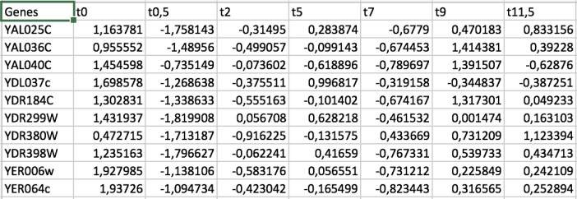
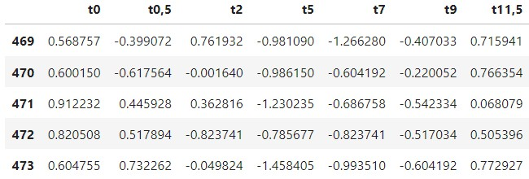
Our dataset
We use the provided dataset, which can be found in sporulation-
filtered.txt
8 columns: Genes t0 t0,5 t2 t5 t7 t9 t11,5
Number of genes: 474 (first one is 0-th)
Number of time intervals: 7
We normalize the dataset: *drop the ‘Genes’ column
*conversion values to float from string
*quantile normalization
5
5

Slide 6
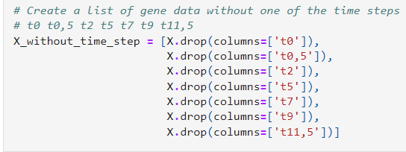
Creation of data without one times step ti

Slide 7
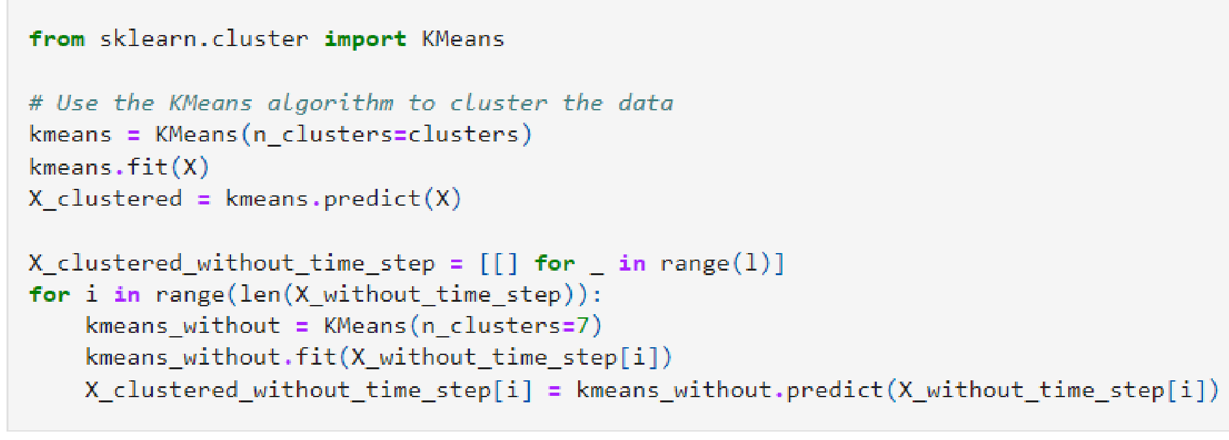
K-means Clustering – implementation of the algorithm

Slide 8
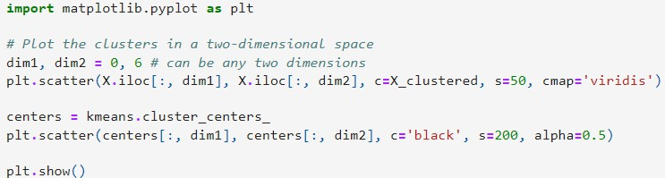
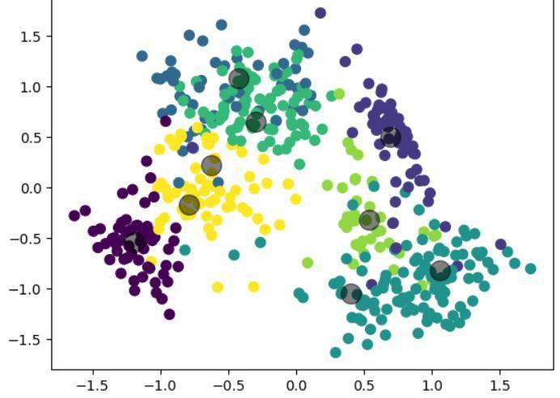
K-means Clustering – execution and results

Slide 9
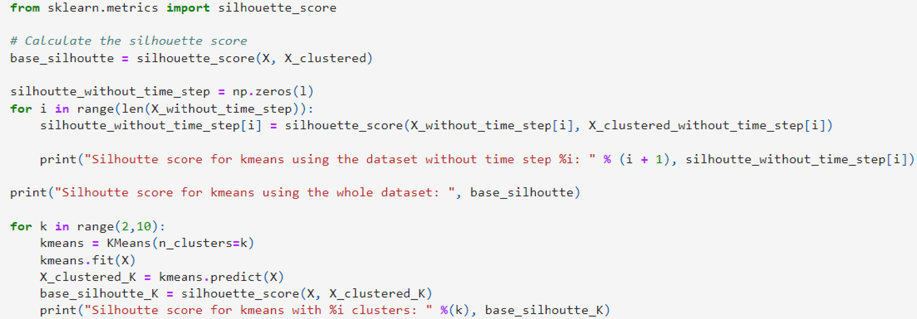
K-means Clustering - counting the silhoutte index

Slide 10

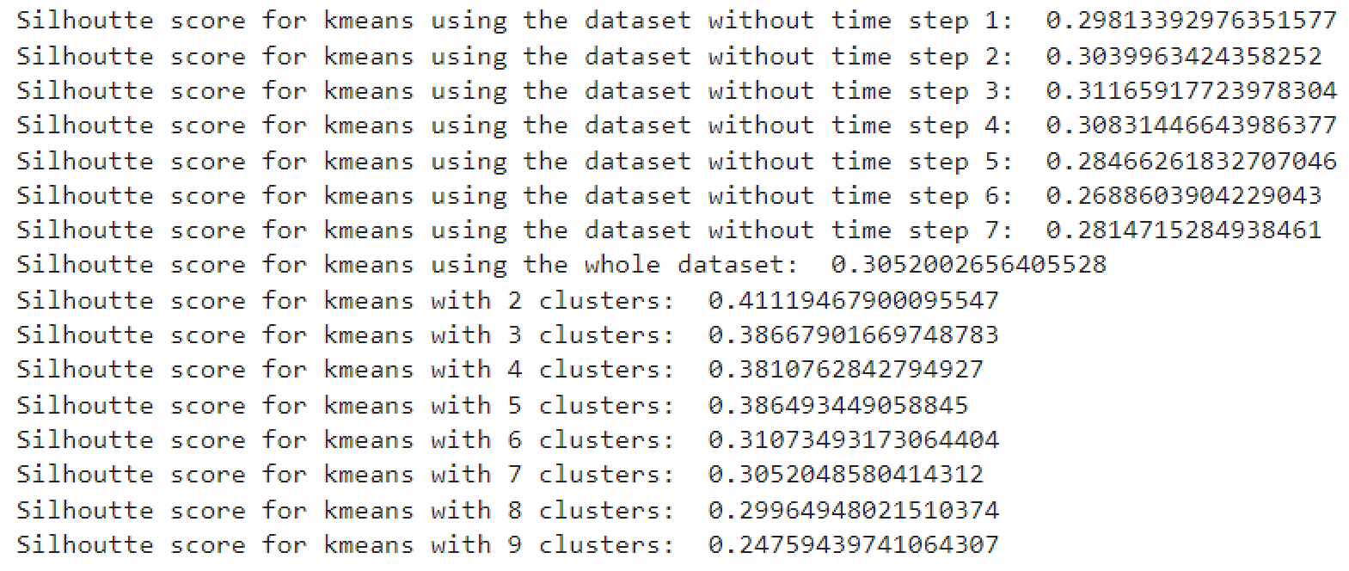
K-means Clustering – evaluating clustering performance
The Silhouette Index is a key metric for assessing the quality of clustering results in your dataset:
Values close to 0 indicate that the data point is located on or near the decision boundary between two or more clusters, suggesting that it is difficult to assign the point to a specific cluster
Values close to 1 indicate that the data point is well-clustered and clearly separated from other clusters
Values close to -1 indicate that the data point is likely misclassified or that the clustering is not well-defined

Slide 11
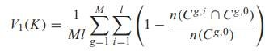
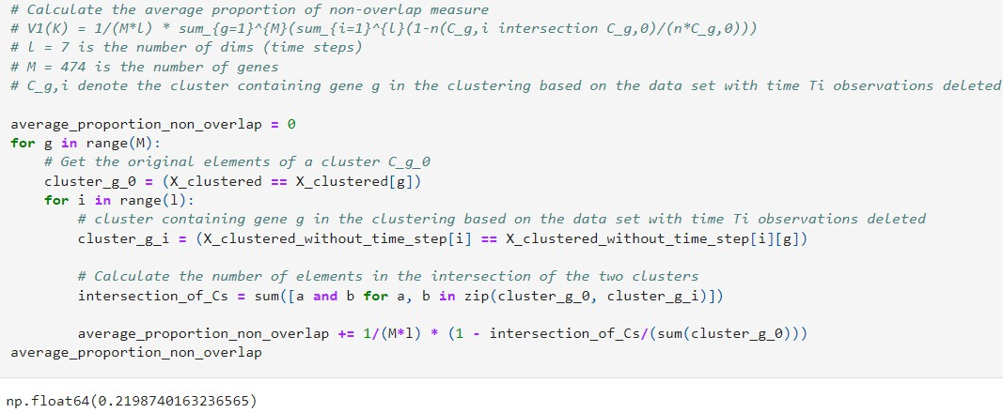
Comparison with existing results 1
The average proportion of non-overlap measure

Slide 12
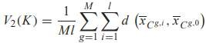
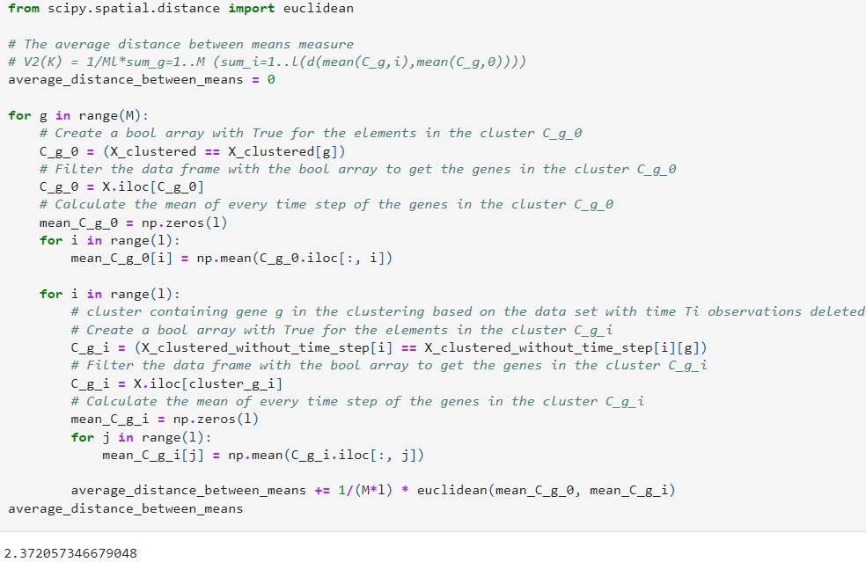
Comparison with existing results 2
The average distance between means measure

Slide 13

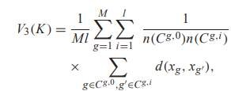
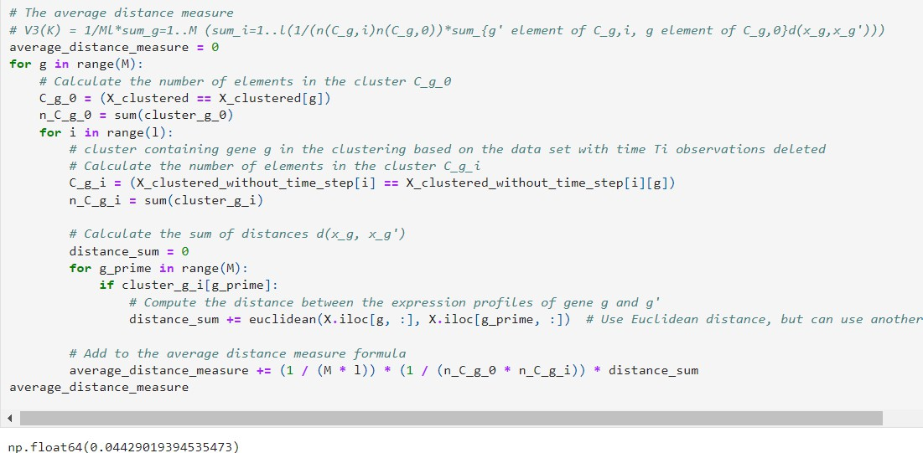
Comparison with existing results 3
The average distance measure, where d(xg, xg) is a distance (e.g. Euclidean,
Manhattan, etc.) between the expression profiles of genes g and g

Slide 14
Comparison with existing results 3
The average distance measure, where d(xg, xg) is a distance (e.g. Euclidean,
Manhattan, etc.) between the expression profiles of genes g and g

Slide 15
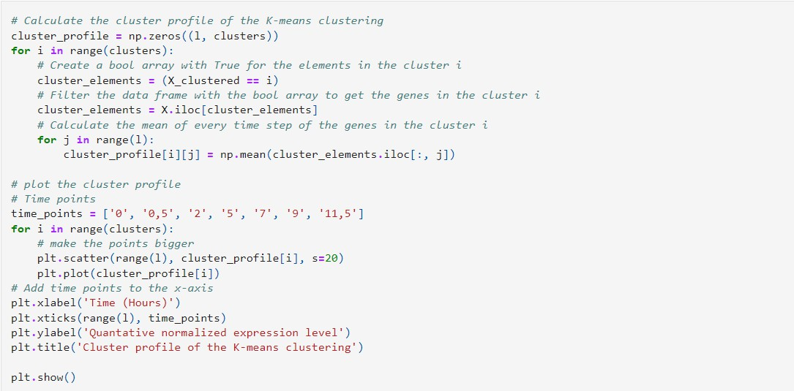
Average temporal profiles

Slide 16
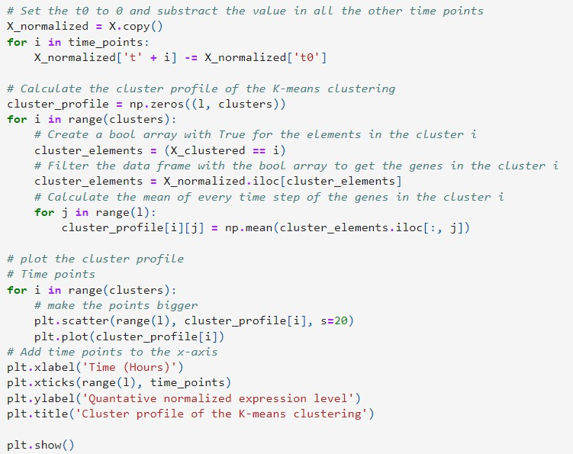
Normalizing the data to start at 0 at time step 0

Slide 17


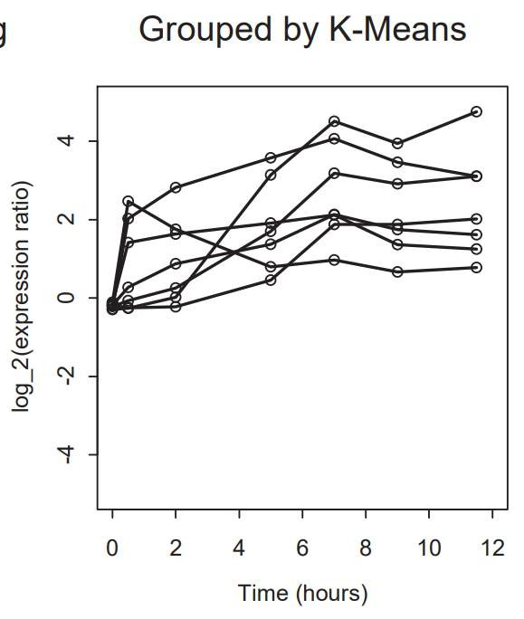
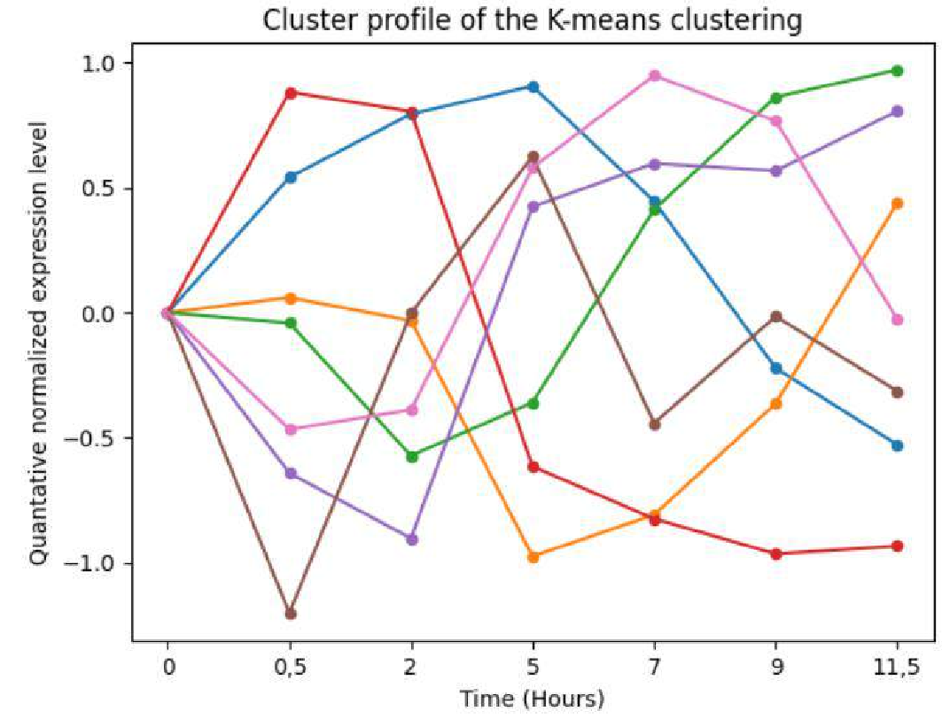
Comparison of the results

Slide 18
Conclusions
Similarity in clusters:
Genes in the same cluster often show similar patterns of expression over time, which suggests they might be regulated together or play roles in related biological processes.
Differences among clusters:
The different patterns seen in various clusters show that gene expression is diverse within the dataset. This indicates that the clustering method has successfully grouped genes
with different functions.

Slide 19
Used sources
Slides from Lecture
https://informatica.cv.uma.es/pluginfile.php/633288/mod_resource/content/0/A1-Comparison-Bioinformatics- 2003-Datta.pdf
https://informatica.cv.uma.es/pluginfile.php/633287/mod_resource/content/1/A2- The%20Transcriptional%20Program%20of%20Sporulation%20in%20Budding%20Yeast.pdf
https://informatica.cv.uma.es/pluginfile.php/633290/mod_resource/content/0/A3-Bioinformatics-2002-Tomida- 1073-83.pdf
https://informatica.cv.uma.es/pluginfile.php/633289/mod_resource/content/0/A4-abstract-yeast-reproduction.pdf
https://informatica.cv.uma.es/pluginfile.php/633291/mod_resource/content/0/A5-Bandyopadhyay-BIO2007.pdf
https://en.wikipedia.org/
https://www.ibm.com/topics/k-means-clustering

Slide 20


Thank you for your attention
Co-authors:
Tomasz Janeczko, Lukáš Hofman
https://github.com/LuhiHofi/Aprendizaje
-Computacional
Lab 1 Task
Aprendizaje Computacional (2024-25) Universidad de Málaga
A free PowerPoint template was used
20

